Slide 1



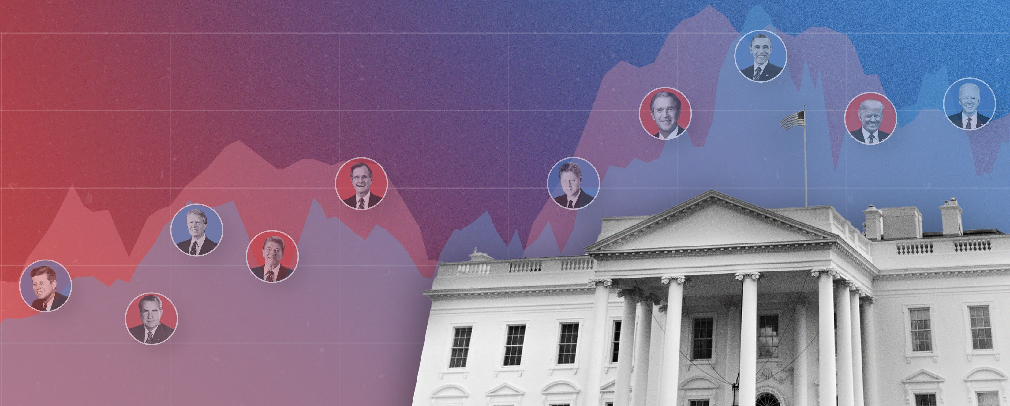
Are you wondering how the presidential election could affect your investments? Every four years, uncertainty about the next president and their policies leads to more uncertainty in the minds of clients. 2024 is no exception, given the election will likely be a rematch between the last two presidents.
We created this guide to answer the most commonly asked questions that we hear from clients during an election year. The findings contained in this guide are purely data-driven and do not serve as investment advice nor political commentary.

Slide 2


How Do Presidential Elections Impact The Market?
How did the market react to Trump’s election vs. Biden’s election?
S&P 500 Performance:
The markets greeted the prospects of a Biden presidency in 2020 with more enthusiasm than they did Trump’s electoral victory in 2016. However, the post-election period for both was generally positive for equities, as the S&P 500 was positive during the entire period from Election Day to inauguration day.
1.11%
11/09/2016
2.20%
11/04/2020
Trump
Biden
Day After Election
~2 Months
After Election Day (Day After Election Through Inauguration Day)
6.16% | 14.33%
11/09/2016 - | 11/04/2020 -
1/20/2017 | 1/20/2021

Slide 3


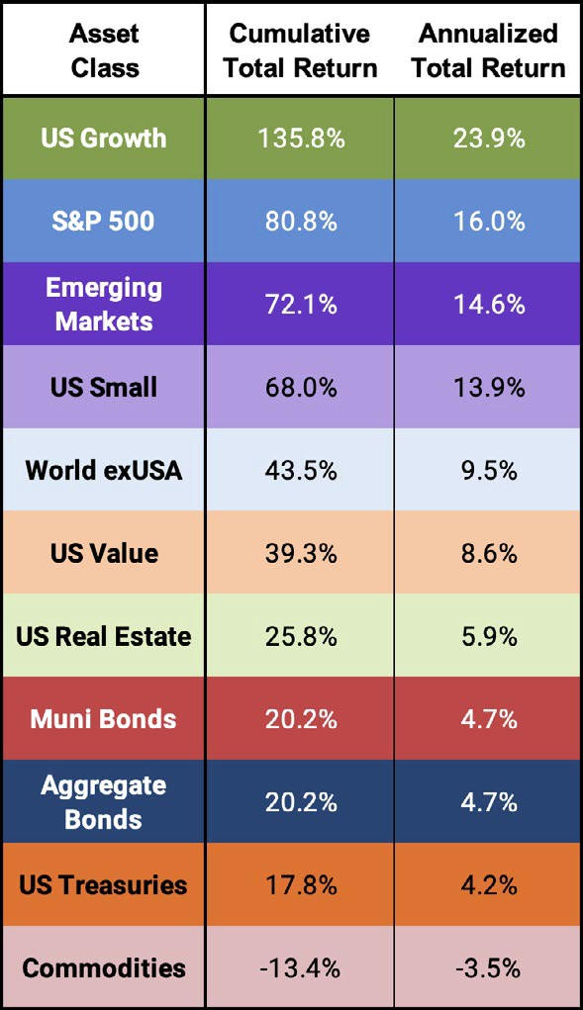
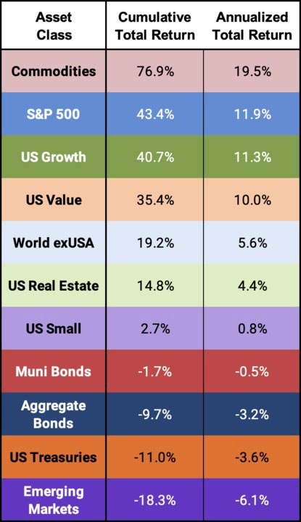
How Do Presidential Elections Impact The Market?
How did various asset classes perform under the last two presidents?
Trump
1/20/2017 - 1/19/2021
Biden
1/20/2021-3/31/2024
Equities have performed considerably well under both presidents, with the exception of Emerging Markets (EM). EM rose 72.1% during Trump’s presidency, but has fallen 18.3% through Q1 2024 of Biden’s tenure. Bond indices also advanced under Trump but have slipped during Biden’s presidency thus far. Commodities were the worst performing and only negative asset class under Trump, but have performed the best under Biden.

Slide 4



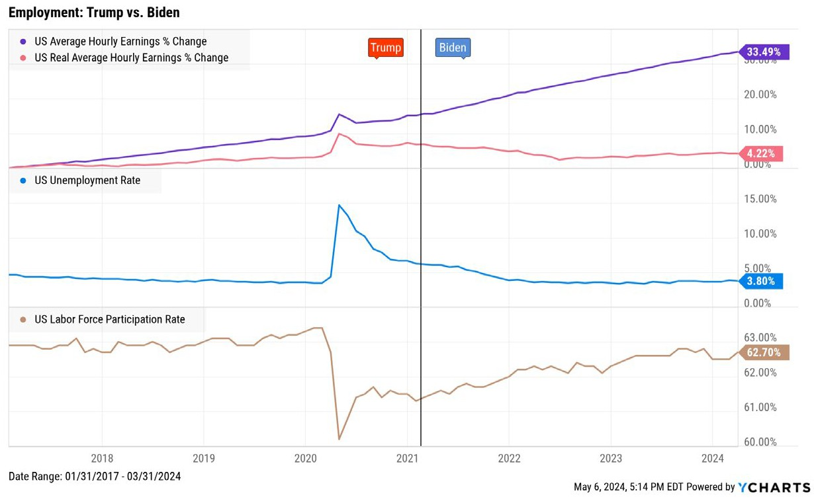
How Do Presidential Elections Impact The Market?
How did the market and economy do under Trump vs. under Biden?

Slide 5

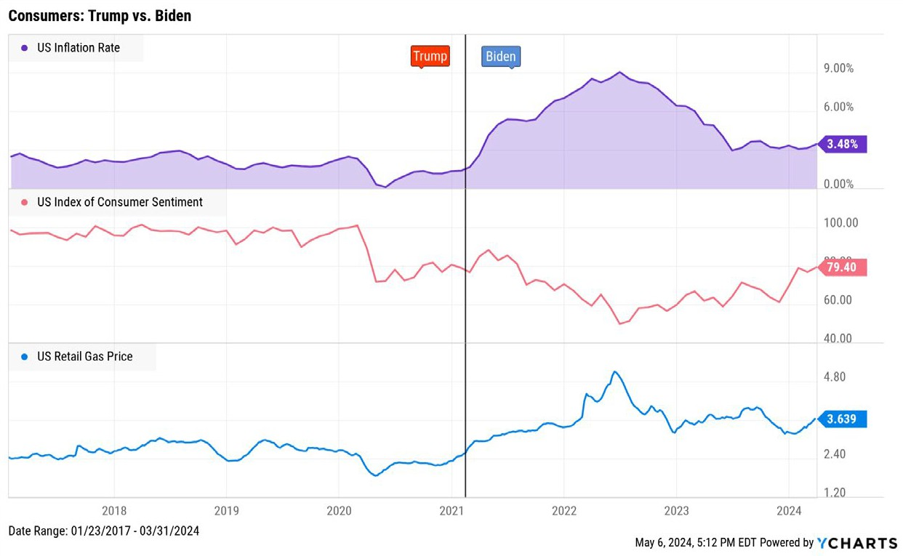
How Do Presidential Elections Impact The Market?
How did the market and economy do under Trump vs. under Biden?

Slide 6

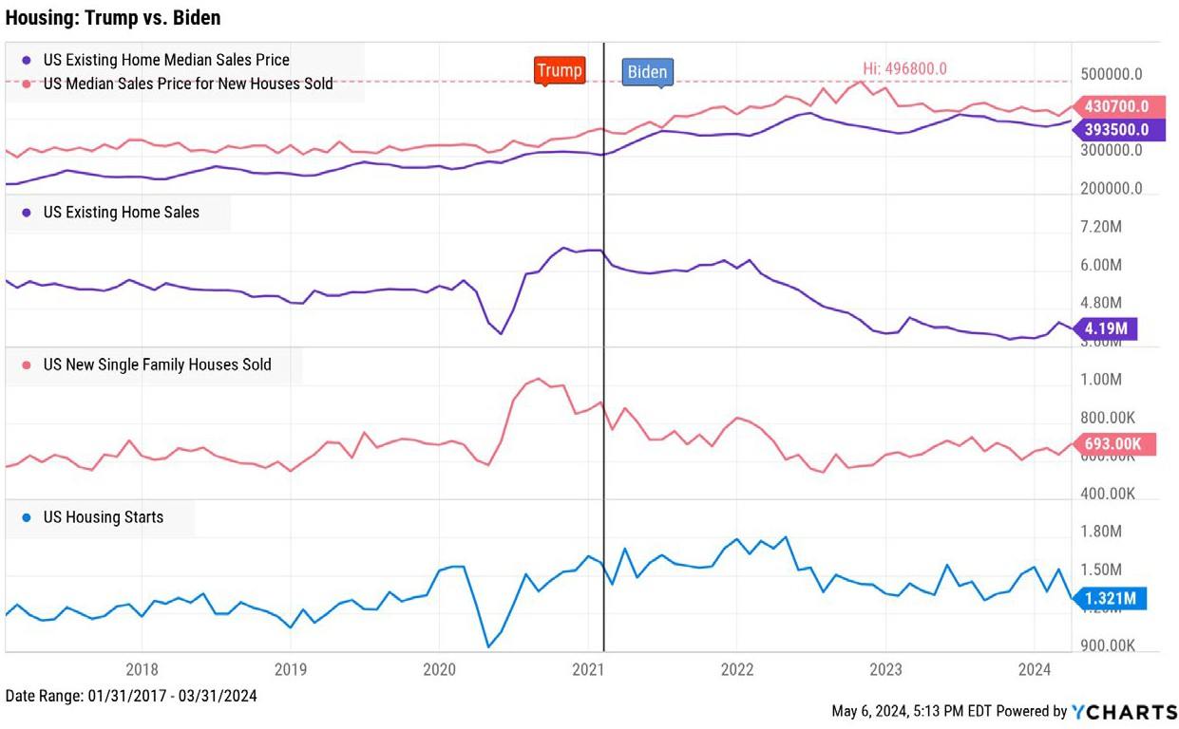
How Do Presidential Elections Impact The Market?
How did the market and economy do under Trump vs. under Biden?

Slide 7

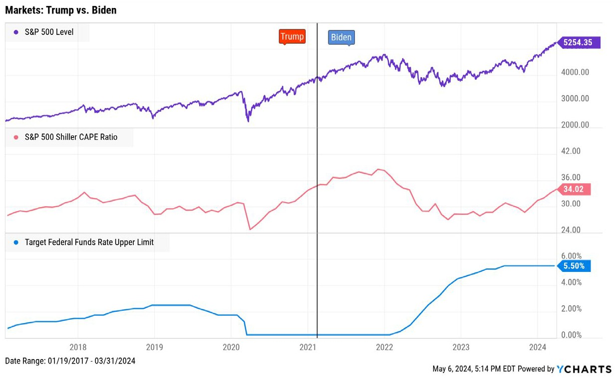
How Do Presidential Elections Impact The Market?
How did the market and economy do under Trump vs. under Biden?

Slide 8

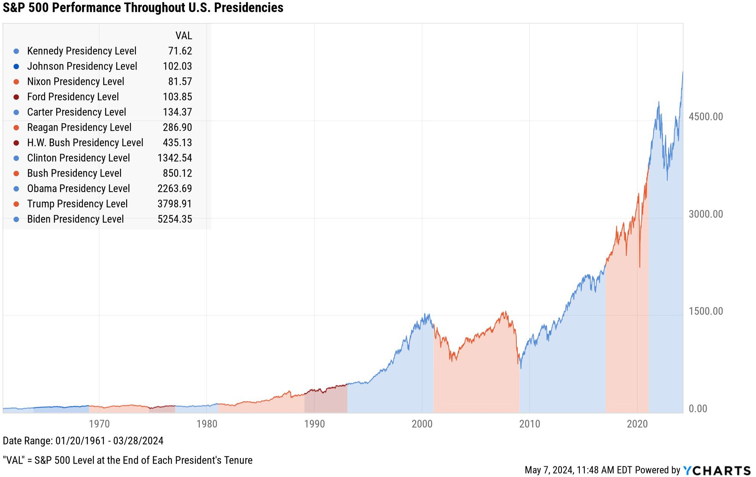












How Do Presidential Elections Impact The Market?
How did markets perform under different presidents?
Dating back to John F. Kennedy’s inauguration in 1961, the S&P 500 posted a negative return during only two presidencies: Richard Nixon and George W. Bush.
The S&P 500 has consistently grown in value over the long term, no matter who’s in office.
Kennedy | Johnson | Nixon | Ford | Carter | Reagan | HW Bush | Clinton | Bush | Obama | Trump | Biden
+19.5% | +46.6% | -19.8% | +28.4% | +30.5% | +117.9% | +51.8% | +209.8% | -36.7% | +181.1% | +67.3% | +36.4%

Slide 9
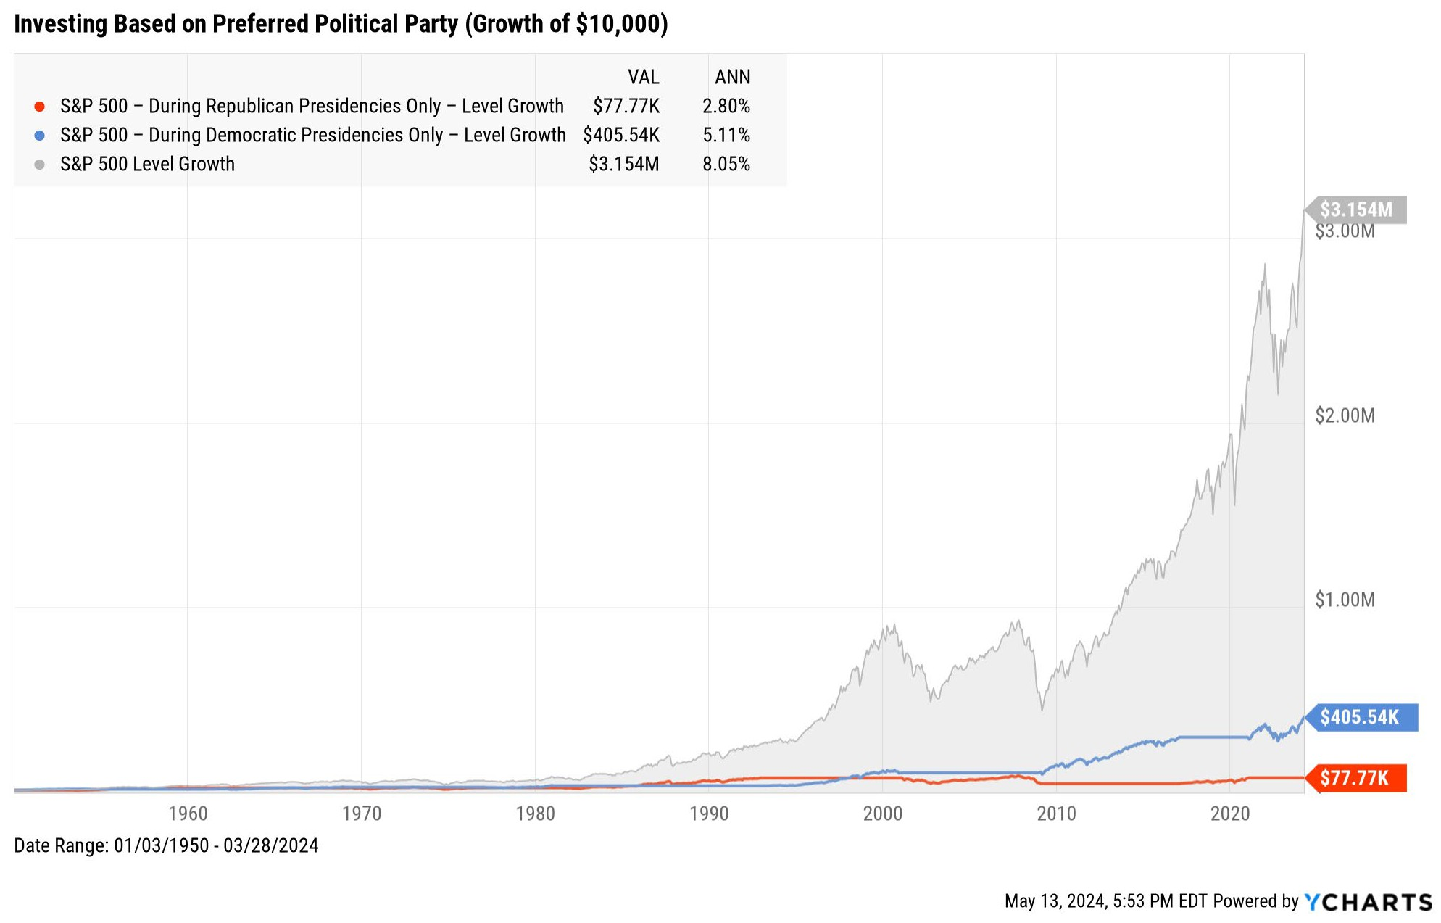


How Do Presidential Elections Impact The Market?
How would you have done if you invested only during the presidencies of one political party?
Making major investment decisions based on a president’s political party–i.e. being invested only during Democratic presidencies, then moving to cash for Republican tenures, or vice versa–is probably hurting your portfolio more than helping it.
Regardless of the party occupying the Oval Office, staying invested is the most prudent long-term strategy.
S&P 500 Investment ^{2.80%} During Only Republican ^{Annualized} Presidencies since 1950 ^{Return}
S&P 500 Investment ^{5.11%} During Only Democratic ^{Annualized} Presidencies since 1950 ^{Return}
S&P 500 Investment ^{8.05%} During All Presidencies ^{Annualized}
Return

Slide 10
How Do Presidential Elections Impact The Market?
How does the market react when
an incumbent president is re-elected? What about when the challenger wins?
In most cases, the S&P 500 posted positive returns between election day and inauguration day, regardless of who wins the presidency.
Since 1952, Democratic presidents winning reelection has historically led to the most significant S&P 500 returns in this post-election period. However, lower returns have tended to occur when the winning candidate was neither an incumbent nor a challenger, such as in election cycles that replace a termed-out president.
Market Reaction to Incumbents and Challengers Being Elected
Day After Election Through Inauguration Day (since 1952)
 | Republican | Democrat | Either Party
Incumbent | +1.07% | +4.82% | +2.68%
Challenger | +2.02% | +5.80% | +4.86%
Neither | +1.80% | -5.57% | -0.31%

Slide 11
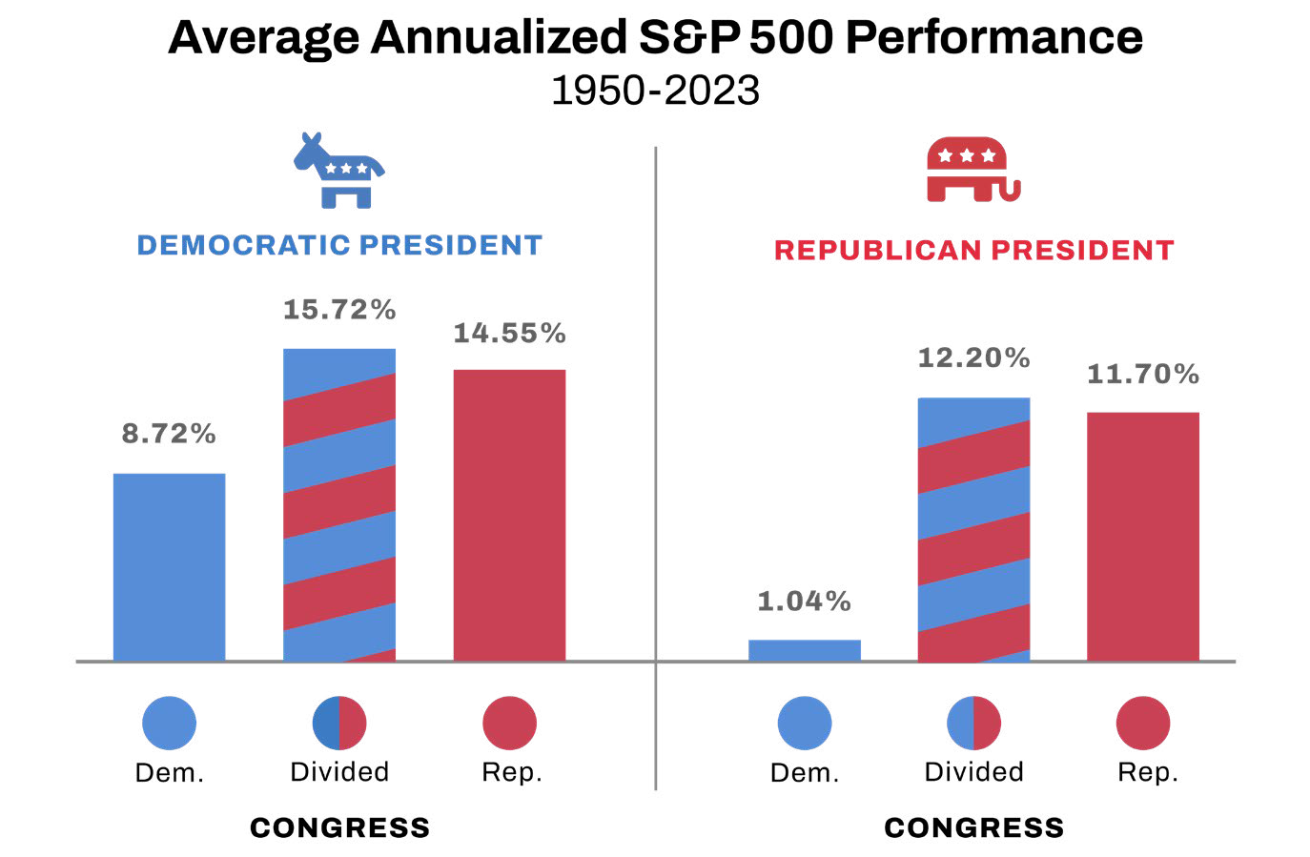
How Do Presidential Elections Impact The Market?
How does one-party
control or a divided Congress impact market returns?
Historically, higher average annualized returns have occurred during a divided Congress, where one party controls the House or Senate and the other party holds a majority in the second chamber. Lower returns have come during Democratic majorities in both the House and Senate, while higher returns have taken place under Republican control of both congressional chambers. In any case, the market has historically been positive under all six government compositions.
Under the current government of Democratic president and divided Congress, the S&P 500 has advanced 36.85% (28.69% annualized) between January 3rd, 2023–when this current Congress was sworn in–and March 31st, 2024, outperforming the 15.72% annualized return historically generated during this legislative formation.

Slide 12
How Do Presidential Elections Impact The Market?
The Bottom Line
The parties occupying the White House and Legislature are just one of many variables that can affect investments. For example, the 2008 Financial Crisis created systematic risk for Presidents Bush and Obama, while the global pandemic in 2020 impacted the market beyond the control of Presidents Trump and Biden.
The most important takeaway for clients: while elections may create some short-term uncertainty, focusing on long-term investing goals should always be the most important factor in investment decision-making.
Sevey Wealth Advisors, LLC is a registered investment advisor located in Austin, TX. Sevey Wealth Advisors, LLC may only transact business in those states in which it is registered or qualifies for an exemption or exclusion from registration requirements. Sevey Wealth Advisors, LLC’s web site is limited to the dissemination of general information pertaining to its advisory services, together with access to additional investment-related information, publications, and links. Accordingly, the publication of Sevey Wealth Advisors, LLC’s web site on the Internet should not be construed by any consumer and/or prospective client as Sevey Wealth Advisors, LLC’s solicitation to effect, or attempt to effect transactions in securities, or the rendering of personalized investment advice for compensation, over the Internet. Any subsequent, direct communication by Sevey Wealth Advisors, LLC with a prospective client shall be conducted by a representative that is either registered or qualifies for an exemption or exclusion from registration in the state where the prospective client resides. For information pertaining to the registration status of Sevey Wealth Advisors, LLC, please contact the state securities regulators for those states in which Sevey Wealth Advisors, LLC maintains a registration filing. A copy of Sevey Wealth Advisors, LLC’s current written disclosure statement discussing Sevey Wealth Advisors, LLC’s business operations, services, and fees is available at the SEC’s investment advisor public information website – www.adviserinfo.sec.gov or from Sevey Wealth Advisors, LLC upon written request. Sevey Wealth Advisors, LLC does not make any representations or warranties as to the accuracy, timeliness, suitability, completeness, or relevance of any information prepared by any unaffiliated third party, whether linked to Sevey Wealth Advisors, LLC’s web site or incorporated herein, and takes no responsibility therefor. All such information is provided solely for convenience purposes only and all users thereof should be guided accordingly. This information are provided for guidance and information purposes only. Investments involve risk and unless otherwise stated, are not guaranteed.
©2024 YCharts, Inc. All Rights Reserved. YCharts, Inc. (“YCharts”) is not registered with the U.S. Securities and Exchange Commission (or with the securities regulatory authority or body of any state or any other jurisdiction) as an investment adviser, broker-dealer, or in any other capacity, and does not purport to provide investment advice or make investment recommendations. This report has been generated through application of the analytical tools and data provided through ycharts.com and is intended solely to assist you or your investment or other adviser(s) in conducting investment research. You should not construe this report as an offer to buy or sell, as a solicitation of an offer to buy or sell, or as a recommendation to buy, sell, hold or trade, any security or other financial instrument. For further information regarding your use of this report, please go to: ycharts.com/about/disclosure.

